Slide 1
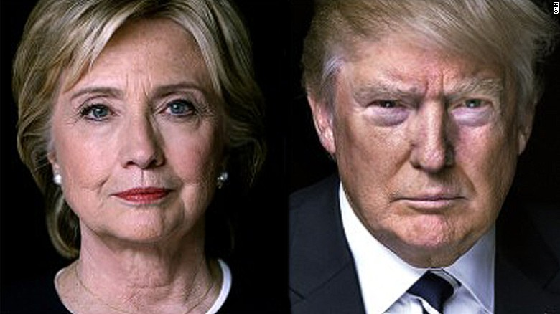

Twitter Analysis of Presidential Candidates
Samriddhi Shakya

Slide 2


Twitter
free social networking and micro-blogging App
text-based posts of up to 140 characters
Tweet
Retweet
Following
Message
Hashtags (#) #PokemonGo #election 2016

Slide 3
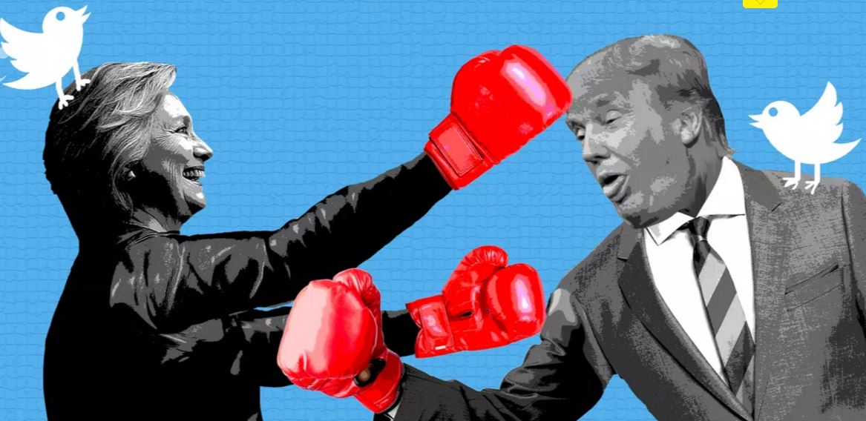
Election 2016

Slide 4

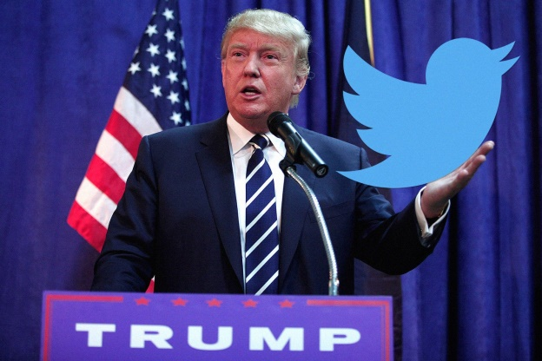
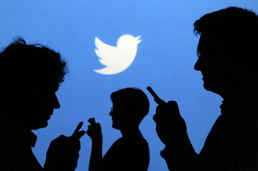
Twitter App
Tweets by Presidential Candidates
2. Tweets by people about Presidential candidates

Slide 5
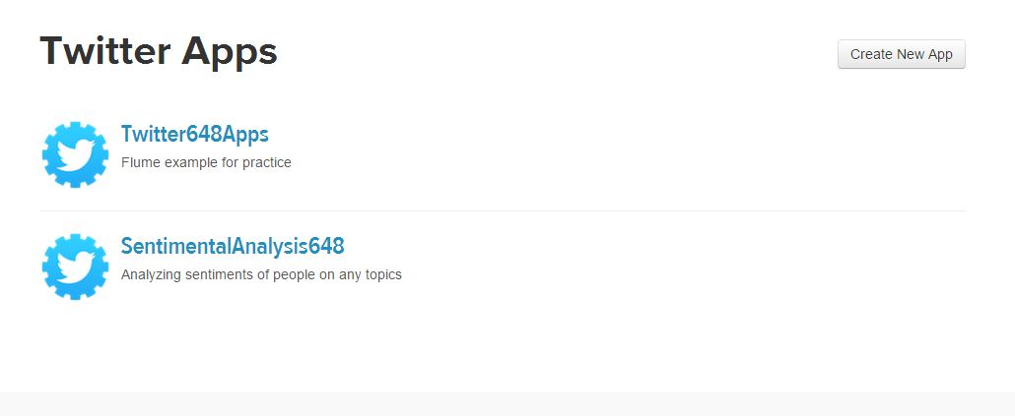
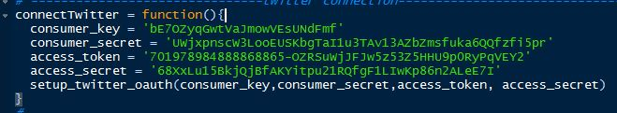
Create Twitter Application

Slide 6
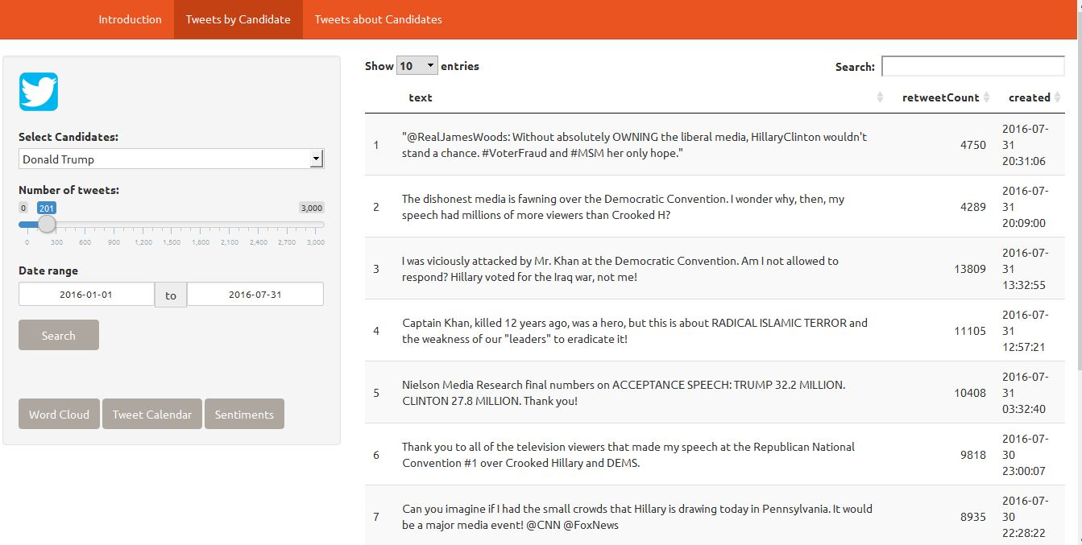

Slide 7
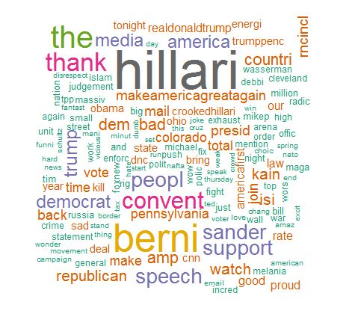
WordCloud

Slide 8
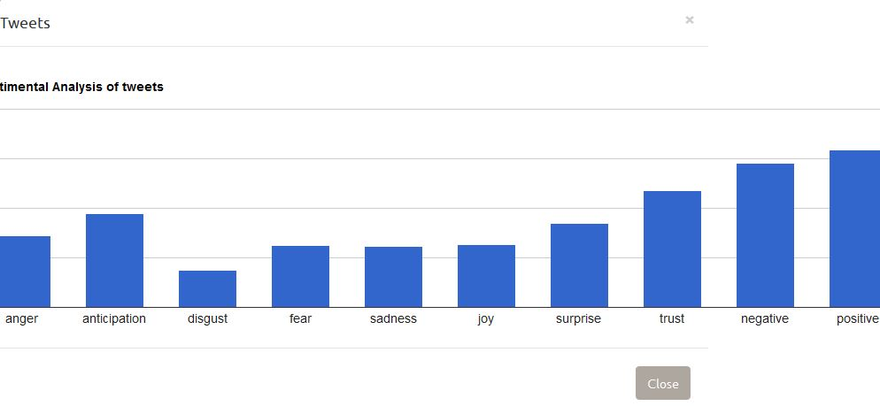
Sentimental Analysis
Based on NRC sentiment dictionary .
classifier to detect the sentiment of messages such as tweets and SMS
calculates eight different emotions and their corresponding valence in a text file.

Slide 9
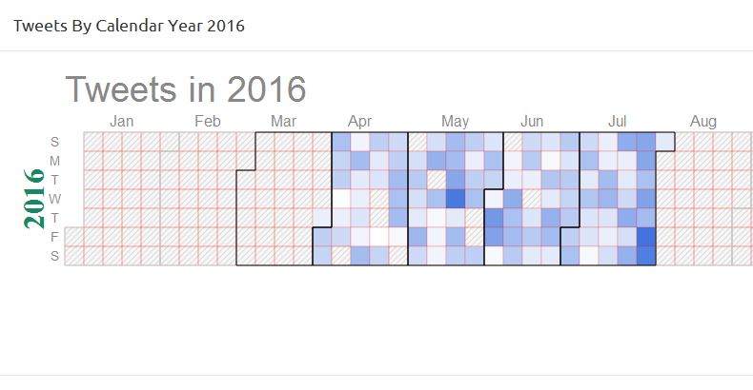
Tweets By Calendar

Slide 10
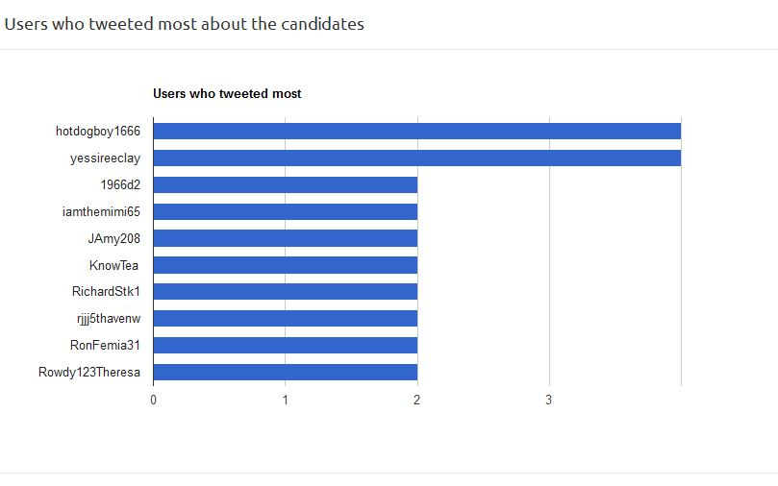
Who Tweeted Most about the Candidates ?

Slide 11
Application Demonstration
http://10.0.0.16:3168/

Slide 12
Future Works
Adding more features
Popular Hashtags
Visualize Retweets

Slide 13


